Slide 1
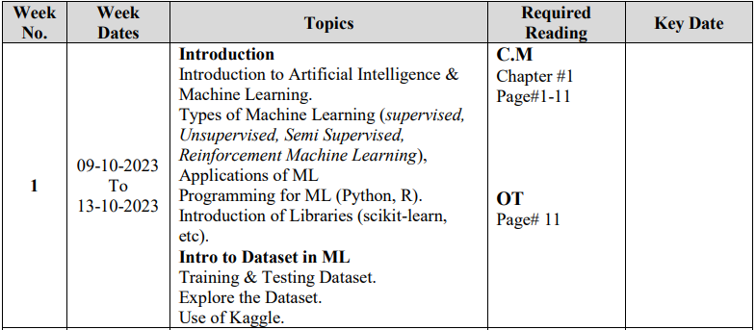

Slide 2
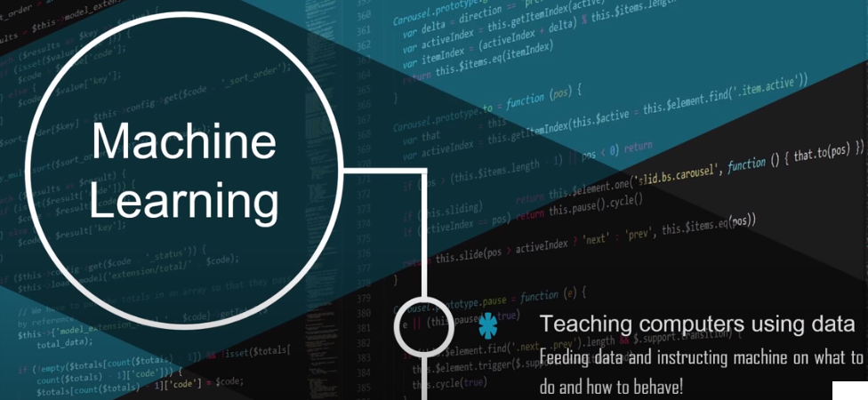
Introduction to Artificial Intelligence and Machine Learning
I. What is Artificial Intelligence (AI)?
AI is a field of computer science that aims to create machines capable of performing tasks that typically require human intelligence.
AI systems can learn from data, reason, solve problems, understand natural language, and perceive their environment.

Slide 3
Introduction to Artificial Intelligence and Machine Learning
II. Machine Learning: A Subset of AI
Machine Learning is a subset of AI that focuses on creating algorithms and models that can learn from data.
Instead of explicitly programming tasks, ML systems improve their performance through experience.
III. The Importance of AI and ML
AI and ML have profound applications in various domains, including healthcare, finance, robotics, and more.
They enable automation, data-driven decision-making, and the development of intelligent systems.

Slide 4
Introduction to Artificial Intelligence and Machine Learning
IV. Key Concepts in Machine Learning
Data: ML algorithms learn from data, which can be structured or unstructured.
Training: ML models are trained on historical data to make predictions or decisions.
Types of Learning: ML includes supervised, unsupervised, and reinforcement learning.
Applications: ML is used for tasks like image recognition, natural language processing, and recommendation systems.
V. Real-World Examples of AI and ML
Chatbots: AI-driven virtual assistants that understand and respond to natural language queries.
Self-Driving Cars: Autonomous vehicles that use ML to navigate and make driving decisions.
Medical Diagnosis: ML models can analyze medical data to aid in disease diagnosis.

Slide 5
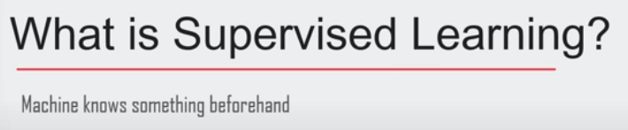
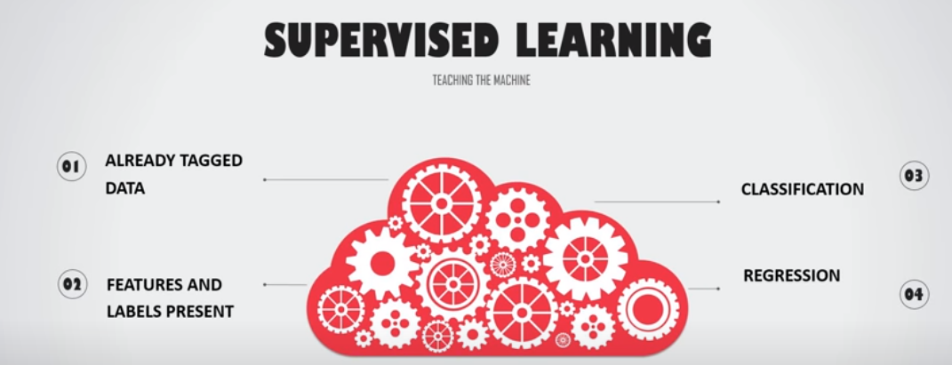
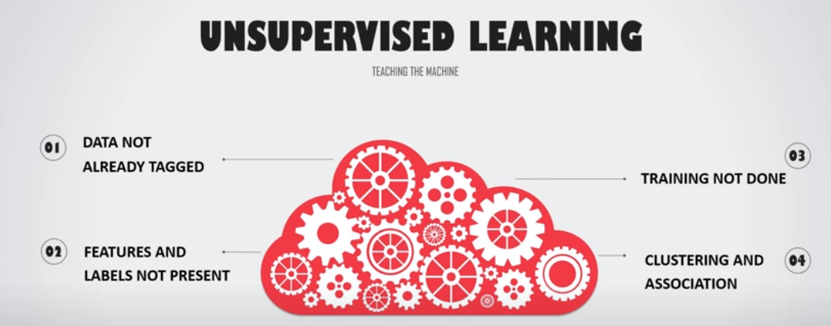

Introduction to Artificial Intelligence and Machine Learning
IV. Key Concepts in Machine Learning
Data: ML algorithms learn from data, which can be structured or unstructured.
Training: ML models are trained on historical data to make predictions or decisions.
Types of Learning: ML includes supervised, unsupervised, and reinforcement learning.
Applications: ML is used for tasks like image recognition, natural language processing, and recommendation systems.

Slide 6
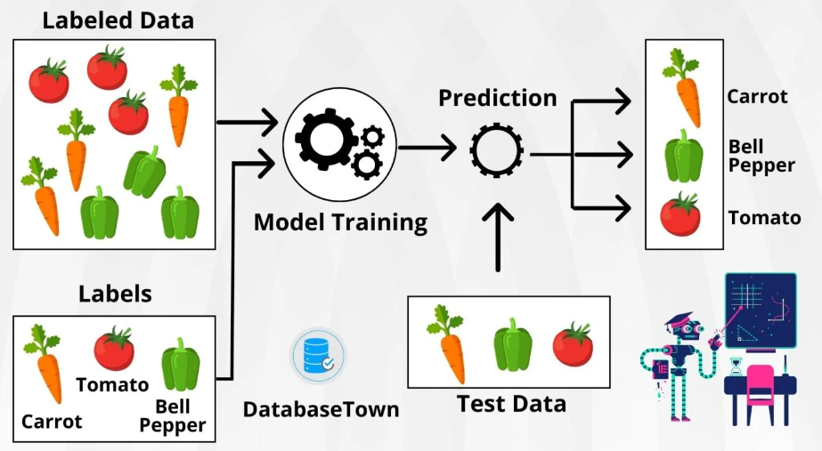
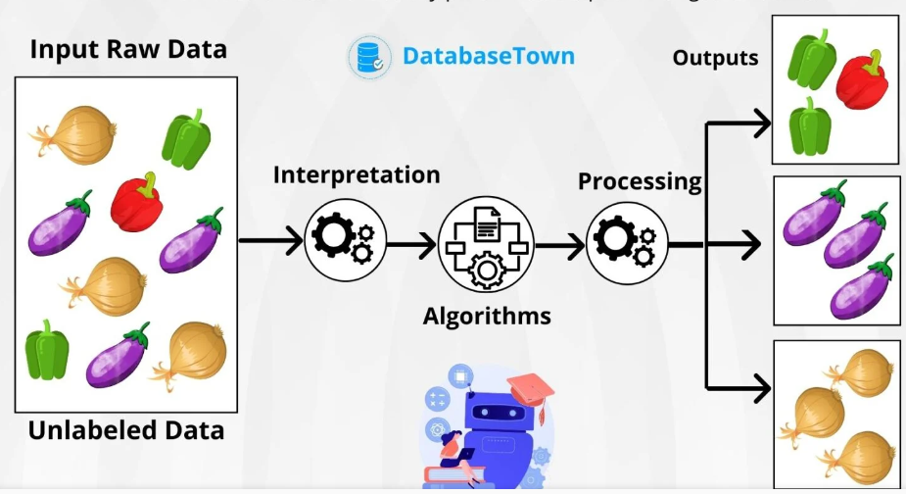
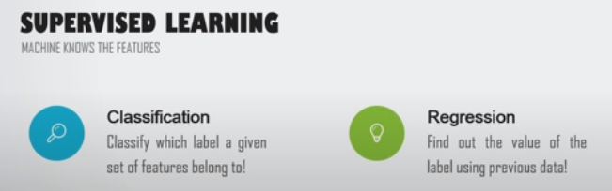
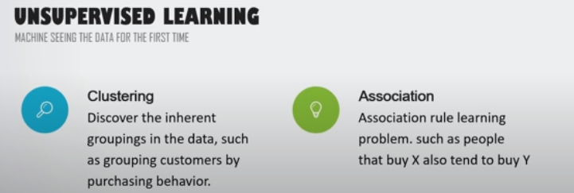
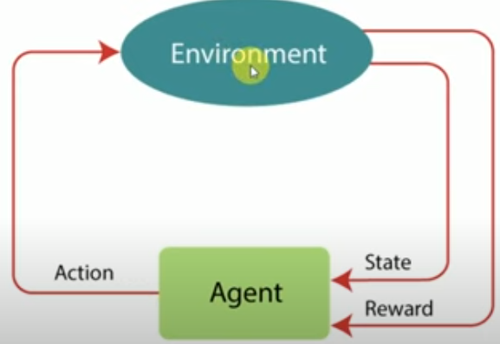


Slide 7
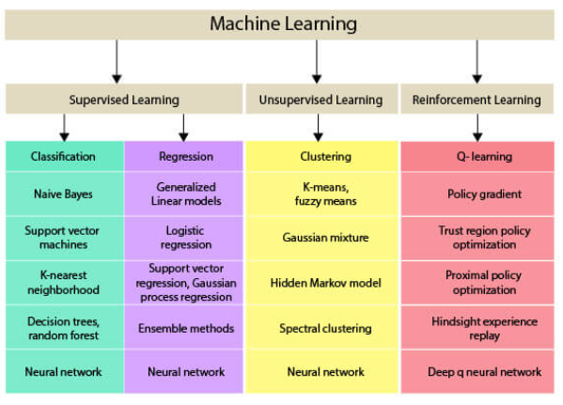
Machine Learning Algorithms

Slide 8
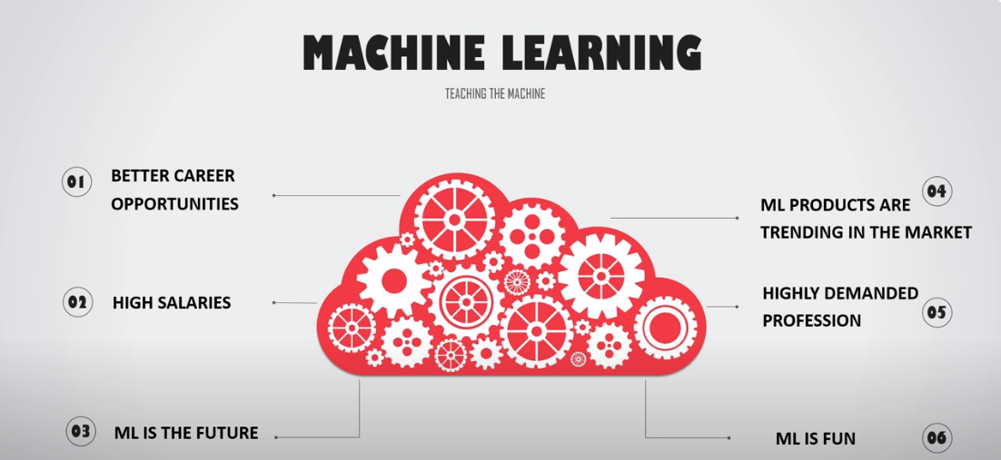
Introduction to Artificial Intelligence and Machine Learning
VI. The Future of AI and ML
AI and ML continue to advance, with deep learning and neural networks at the forefront.
Ethical considerations, privacy, and AI safety are important topics in AI development.
The job market for AI and ML professionals is growing rapidly.

Slide 9
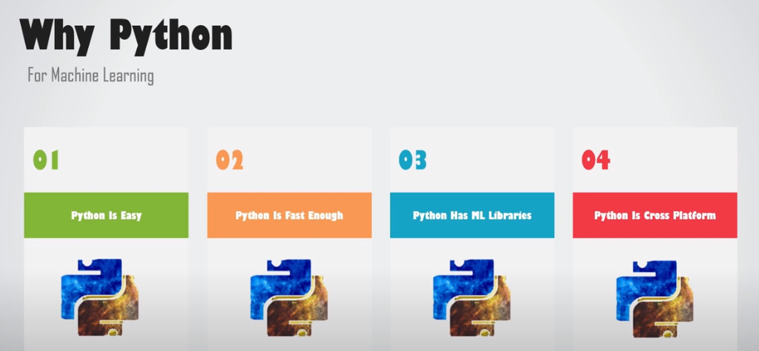
Why Programming of Machine Learning in Python?
Programming Machine Learning in Python is a popular choice for several reasons:
Ease of Learning:
Abundant Libraries and Frameworks: :
Community and Support:
Flexibility:
Libraries for Data Manipulation:
Visualization Tools:
Open Source:
Interoperability:
Notes:
Programming Machine Learning in Python is a popular choice for several compelling reasons:
1. **Abundant Libraries and Frameworks**: Python has a rich ecosystem of libraries and frameworks specifically designed for machine learning and data science, such as TensorFlow, PyTorch, Scikit-Learn, and Keras. These libraries provide pre-built tools and functions that simplify the implementation of complex machine learning models. This extensive collection of resources accelerates development and research.
2. **Ease of Learning**: Python is renowned for its simplicity and readability. Its straightforward and human-readable syntax makes it accessible to both beginners and experienced programmers. The ease of learning Python reduces the learning curve for individuals entering the field of machine learning.
3. **Community Support**: Python boasts a large and active community of developers, data scientists, and machine learning practitioners. This vibrant community provides a wealth of tutorials, documentation, and online forums where you can seek help, share knowledge, and collaborate on projects. This support network is invaluable for learning and troubleshooting.
4. **Cross-Platform Compatibility**: Python is a cross-platform language, meaning that code written in Python can run on various operating systems without significant modifications. This cross-compatibility simplifies the deployment of machine learning models across different environments.
5. **Integration with Data Science Tools**: Python seamlessly integrates with essential data science tools, including Jupyter Notebooks, pandas, NumPy, and matplotlib. These tools facilitate data manipulation, visualization, and analysis, which are fundamental components of any machine learning project.
6. **Large Dataset Handling**: Python offers efficient mechanisms for handling large datasets. Libraries like Dask and Vaex are designed for scalable data processing and analysis, making Python suitable for big data and data-intensive machine learning tasks.
7. **Active Development**: Python is actively developed and updated, ensuring that it remains up-to-date with the latest advancements in machine learning and data science. This continuous development cycle keeps Python relevant and competitive in the field.
8. **Versatility**: Python is not limited to machine learning; it is a versatile language used in web development, scripting, automation, scientific computing, and more. This versatility makes Python a valuable skill for professionals working in various domains, enhancing career opportunities.
9. **Deployment and Productionization**: Python's popularity in the industry means that it has well-established tools and frameworks for deploying machine learning models in real-world applications. Frameworks like Flask and Django make it relatively straightforward to convert machine learning models into web services and deploy them for practical use.
10. **Educational Resources**: Many online courses, books, and tutorials are focused on machine learning in Python. These resources make it an excellent choice for self-learners and individuals pursuing formal education in machine learning, providing a wealth of educational materials and a supportive community.
In summary, Python's extensive libraries, ease of learning, strong community support, cross-platform compatibility, integration with data science tools, and versatility have collectively made it the preferred language for programming machine learning solutions. Python's broad adoption in academia and industry reinforces its status as a top choice for machine learning practitioners.

Slide 10
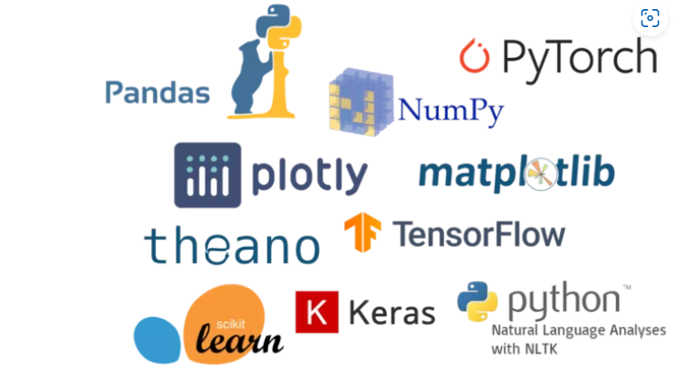
Introduction of Libraries of Python
Notes:
Programming Machine Learning in Python is a popular choice for several compelling reasons:
1. **Abundant Libraries and Frameworks**: Python has a rich ecosystem of libraries and frameworks specifically designed for machine learning and data science, such as TensorFlow, PyTorch, Scikit-Learn, and Keras. These libraries provide pre-built tools and functions that simplify the implementation of complex machine learning models. This extensive collection of resources accelerates development and research.
2. **Ease of Learning**: Python is renowned for its simplicity and readability. Its straightforward and human-readable syntax makes it accessible to both beginners and experienced programmers. The ease of learning Python reduces the learning curve for individuals entering the field of machine learning.
3. **Community Support**: Python boasts a large and active community of developers, data scientists, and machine learning practitioners. This vibrant community provides a wealth of tutorials, documentation, and online forums where you can seek help, share knowledge, and collaborate on projects. This support network is invaluable for learning and troubleshooting.
4. **Cross-Platform Compatibility**: Python is a cross-platform language, meaning that code written in Python can run on various operating systems without significant modifications. This cross-compatibility simplifies the deployment of machine learning models across different environments.
5. **Integration with Data Science Tools**: Python seamlessly integrates with essential data science tools, including Jupyter Notebooks, pandas, NumPy, and matplotlib. These tools facilitate data manipulation, visualization, and analysis, which are fundamental components of any machine learning project.
6. **Large Dataset Handling**: Python offers efficient mechanisms for handling large datasets. Libraries like Dask and Vaex are designed for scalable data processing and analysis, making Python suitable for big data and data-intensive machine learning tasks.
7. **Active Development**: Python is actively developed and updated, ensuring that it remains up-to-date with the latest advancements in machine learning and data science. This continuous development cycle keeps Python relevant and competitive in the field.
8. **Versatility**: Python is not limited to machine learning; it is a versatile language used in web development, scripting, automation, scientific computing, and more. This versatility makes Python a valuable skill for professionals working in various domains, enhancing career opportunities.
9. **Deployment and Productionization**: Python's popularity in the industry means that it has well-established tools and frameworks for deploying machine learning models in real-world applications. Frameworks like Flask and Django make it relatively straightforward to convert machine learning models into web services and deploy them for practical use.
10. **Educational Resources**: Many online courses, books, and tutorials are focused on machine learning in Python. These resources make it an excellent choice for self-learners and individuals pursuing formal education in machine learning, providing a wealth of educational materials and a supportive community.
In summary, Python's extensive libraries, ease of learning, strong community support, cross-platform compatibility, integration with data science tools, and versatility have collectively made it the preferred language for programming machine learning solutions. Python's broad adoption in academia and industry reinforces its status as a top choice for machine learning practitioners.

Slide 11
Introduction of Libraries of Python
NumPy (Numerical Python):
Purpose: NumPy is fundamental for numerical and array operations. It provides support for multi-dimensional arrays and matrices, along with mathematical functions to operate on them efficiently.
Key Features: Arrays, element-wise operations, linear algebra, random number generation.
Example: Calculating the mean and standard deviation of a dataset.
Pandas:
Purpose: Pandas is essential for data manipulation and analysis. It offers data structures like DataFrames and Series, making it easier to work with structured data.
Key Features: DataFrames, data cleaning, data aggregation, time-series analysis.
Example: Loading, filtering, and summarizing a dataset.
Matplotlib:
Purpose: Matplotlib is a powerful library for creating static, animated, or interactive visualizations in Python.
Key Features: Line plots, scatter plots, bar charts, histograms.
Example: Plotting a graph to visualize data trends.
Notes:
Programming Machine Learning in Python is a popular choice for several compelling reasons:
1. **Abundant Libraries and Frameworks**: Python has a rich ecosystem of libraries and frameworks specifically designed for machine learning and data science, such as TensorFlow, PyTorch, Scikit-Learn, and Keras. These libraries provide pre-built tools and functions that simplify the implementation of complex machine learning models. This extensive collection of resources accelerates development and research.
2. **Ease of Learning**: Python is renowned for its simplicity and readability. Its straightforward and human-readable syntax makes it accessible to both beginners and experienced programmers. The ease of learning Python reduces the learning curve for individuals entering the field of machine learning.
3. **Community Support**: Python boasts a large and active community of developers, data scientists, and machine learning practitioners. This vibrant community provides a wealth of tutorials, documentation, and online forums where you can seek help, share knowledge, and collaborate on projects. This support network is invaluable for learning and troubleshooting.
4. **Cross-Platform Compatibility**: Python is a cross-platform language, meaning that code written in Python can run on various operating systems without significant modifications. This cross-compatibility simplifies the deployment of machine learning models across different environments.
5. **Integration with Data Science Tools**: Python seamlessly integrates with essential data science tools, including Jupyter Notebooks, pandas, NumPy, and matplotlib. These tools facilitate data manipulation, visualization, and analysis, which are fundamental components of any machine learning project.
6. **Large Dataset Handling**: Python offers efficient mechanisms for handling large datasets. Libraries like Dask and Vaex are designed for scalable data processing and analysis, making Python suitable for big data and data-intensive machine learning tasks.
7. **Active Development**: Python is actively developed and updated, ensuring that it remains up-to-date with the latest advancements in machine learning and data science. This continuous development cycle keeps Python relevant and competitive in the field.
8. **Versatility**: Python is not limited to machine learning; it is a versatile language used in web development, scripting, automation, scientific computing, and more. This versatility makes Python a valuable skill for professionals working in various domains, enhancing career opportunities.
9. **Deployment and Productionization**: Python's popularity in the industry means that it has well-established tools and frameworks for deploying machine learning models in real-world applications. Frameworks like Flask and Django make it relatively straightforward to convert machine learning models into web services and deploy them for practical use.
10. **Educational Resources**: Many online courses, books, and tutorials are focused on machine learning in Python. These resources make it an excellent choice for self-learners and individuals pursuing formal education in machine learning, providing a wealth of educational materials and a supportive community.
In summary, Python's extensive libraries, ease of learning, strong community support, cross-platform compatibility, integration with data science tools, and versatility have collectively made it the preferred language for programming machine learning solutions. Python's broad adoption in academia and industry reinforces its status as a top choice for machine learning practitioners.

Slide 12
Introduction of Libraries of Python
Seaborn:
Purpose: Seaborn is built on top of Matplotlib and provides a higher-level interface for creating informative and attractive statistical graphics.
Key Features: Enhanced data visualization, support for complex plots.
Example: Creating a heatmap or pair plot for data analysis.
Scikit-Learn:
Purpose: Scikit-Learn is a machine learning library that offers tools for data preprocessing, model selection, evaluation, and deployment.
Key Features: Classification, regression, clustering, model evaluation, feature selection.
Example: Building a machine learning model for predicting house prices.
TensorFlow and PyTorch:
Purpose: TensorFlow and PyTorch are deep learning frameworks used for building and training neural networks. They are widely employed in applications like computer vision and natural language processing.
Key Features: Deep learning, neural network design, GPU acceleration.
Example: Creating a convolutional neural network (CNN) for image recognition
Notes:
Programming Machine Learning in Python is a popular choice for several compelling reasons:
1. **Abundant Libraries and Frameworks**: Python has a rich ecosystem of libraries and frameworks specifically designed for machine learning and data science, such as TensorFlow, PyTorch, Scikit-Learn, and Keras. These libraries provide pre-built tools and functions that simplify the implementation of complex machine learning models. This extensive collection of resources accelerates development and research.
2. **Ease of Learning**: Python is renowned for its simplicity and readability. Its straightforward and human-readable syntax makes it accessible to both beginners and experienced programmers. The ease of learning Python reduces the learning curve for individuals entering the field of machine learning.
3. **Community Support**: Python boasts a large and active community of developers, data scientists, and machine learning practitioners. This vibrant community provides a wealth of tutorials, documentation, and online forums where you can seek help, share knowledge, and collaborate on projects. This support network is invaluable for learning and troubleshooting.
4. **Cross-Platform Compatibility**: Python is a cross-platform language, meaning that code written in Python can run on various operating systems without significant modifications. This cross-compatibility simplifies the deployment of machine learning models across different environments.
5. **Integration with Data Science Tools**: Python seamlessly integrates with essential data science tools, including Jupyter Notebooks, pandas, NumPy, and matplotlib. These tools facilitate data manipulation, visualization, and analysis, which are fundamental components of any machine learning project.
6. **Large Dataset Handling**: Python offers efficient mechanisms for handling large datasets. Libraries like Dask and Vaex are designed for scalable data processing and analysis, making Python suitable for big data and data-intensive machine learning tasks.
7. **Active Development**: Python is actively developed and updated, ensuring that it remains up-to-date with the latest advancements in machine learning and data science. This continuous development cycle keeps Python relevant and competitive in the field.
8. **Versatility**: Python is not limited to machine learning; it is a versatile language used in web development, scripting, automation, scientific computing, and more. This versatility makes Python a valuable skill for professionals working in various domains, enhancing career opportunities.
9. **Deployment and Productionization**: Python's popularity in the industry means that it has well-established tools and frameworks for deploying machine learning models in real-world applications. Frameworks like Flask and Django make it relatively straightforward to convert machine learning models into web services and deploy them for practical use.
10. **Educational Resources**: Many online courses, books, and tutorials are focused on machine learning in Python. These resources make it an excellent choice for self-learners and individuals pursuing formal education in machine learning, providing a wealth of educational materials and a supportive community.
In summary, Python's extensive libraries, ease of learning, strong community support, cross-platform compatibility, integration with data science tools, and versatility have collectively made it the preferred language for programming machine learning solutions. Python's broad adoption in academia and industry reinforces its status as a top choice for machine learning practitioners.

Slide 13
Introduction of Libraries of Python
Flask and Django:
Purpose: Flask and Django are web development frameworks. Flask is lightweight and ideal for small to medium-sized web applications, while Django is a comprehensive framework for larger projects.
Key Features: Routing, templating, database integration (Django includes an ORM).
Example: Building a simple web app to collect user feedback.
Requests:
Purpose: The Requests library simplifies HTTP requests, making it easy to interact with web services and APIs.
Key Features: HTTP GET, POST, PUT, and DELETE requests, handling response data.
Example: Sending a GET request to retrieve data from a RESTful API.
Notes:
Programming Machine Learning in Python is a popular choice for several compelling reasons:
1. **Abundant Libraries and Frameworks**: Python has a rich ecosystem of libraries and frameworks specifically designed for machine learning and data science, such as TensorFlow, PyTorch, Scikit-Learn, and Keras. These libraries provide pre-built tools and functions that simplify the implementation of complex machine learning models. This extensive collection of resources accelerates development and research.
2. **Ease of Learning**: Python is renowned for its simplicity and readability. Its straightforward and human-readable syntax makes it accessible to both beginners and experienced programmers. The ease of learning Python reduces the learning curve for individuals entering the field of machine learning.
3. **Community Support**: Python boasts a large and active community of developers, data scientists, and machine learning practitioners. This vibrant community provides a wealth of tutorials, documentation, and online forums where you can seek help, share knowledge, and collaborate on projects. This support network is invaluable for learning and troubleshooting.
4. **Cross-Platform Compatibility**: Python is a cross-platform language, meaning that code written in Python can run on various operating systems without significant modifications. This cross-compatibility simplifies the deployment of machine learning models across different environments.
5. **Integration with Data Science Tools**: Python seamlessly integrates with essential data science tools, including Jupyter Notebooks, pandas, NumPy, and matplotlib. These tools facilitate data manipulation, visualization, and analysis, which are fundamental components of any machine learning project.
6. **Large Dataset Handling**: Python offers efficient mechanisms for handling large datasets. Libraries like Dask and Vaex are designed for scalable data processing and analysis, making Python suitable for big data and data-intensive machine learning tasks.
7. **Active Development**: Python is actively developed and updated, ensuring that it remains up-to-date with the latest advancements in machine learning and data science. This continuous development cycle keeps Python relevant and competitive in the field.
8. **Versatility**: Python is not limited to machine learning; it is a versatile language used in web development, scripting, automation, scientific computing, and more. This versatility makes Python a valuable skill for professionals working in various domains, enhancing career opportunities.
9. **Deployment and Productionization**: Python's popularity in the industry means that it has well-established tools and frameworks for deploying machine learning models in real-world applications. Frameworks like Flask and Django make it relatively straightforward to convert machine learning models into web services and deploy them for practical use.
10. **Educational Resources**: Many online courses, books, and tutorials are focused on machine learning in Python. These resources make it an excellent choice for self-learners and individuals pursuing formal education in machine learning, providing a wealth of educational materials and a supportive community.
In summary, Python's extensive libraries, ease of learning, strong community support, cross-platform compatibility, integration with data science tools, and versatility have collectively made it the preferred language for programming machine learning solutions. Python's broad adoption in academia and industry reinforces its status as a top choice for machine learning practitioners.

Slide 14

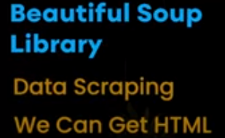

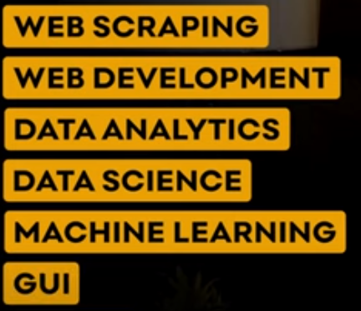


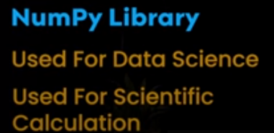


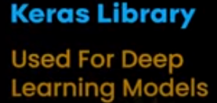

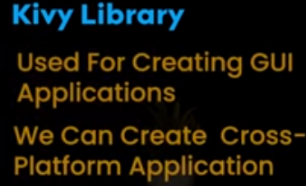


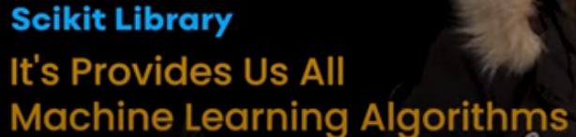

Summary of Library types

